Slide 1
Object-Oriented Design
T.Shokatpour

Slide 2
Object-Oriented Design
It's a way of structuring your software
OOD requires the programmer to think of a program in terms of objects, instead of procedures / VI's
An object:
Encapsulated data and the methods for accessing that data
“Cluster + VI's”
Group of VI's with a common responsibility

Slide 3
Object-Oriented Programming
OOP uses objects and their interactions to design applications
OOP is bases on programming techniques such as encapsulation, inheritance and polymorphism

Slide 4
When and why to use Object-Orientation?
Use it when you want
Encapsulation
Inheritance
Dynamic dispatching (polymorphism)
Or when you want to start using OO Design Patterns!
Benefits of OOP
Easier to maintain your code
Easier to extend your code
Easier to test your code
Increase of code reuse
Benefits increase when the system grows

Slide 5
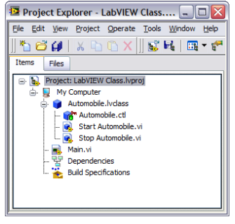

What is a LabVIEW class?
A cluster
A user-defined data type
A type of Project Library
Anatomy of a class
Class file (.lvclass) stores class information
–Private data control definition
–List of member VIs
–Properties of member VI

Slide 6
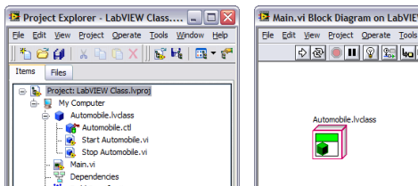
What is an Object?
An object is a specific instance of a class
Object data and methods are defined by the class

Slide 7
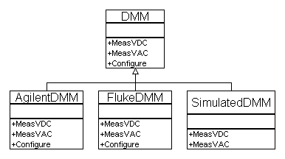
Inheritance
Creates replaceability between classes which:
– Inherit from the same ancestor
– Have the same public VI's (methods)
Benefits
– Code reuse combined with specialization → Design Patterns!
– Changes to parent propagate to children

Slide 8
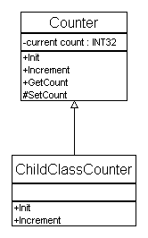
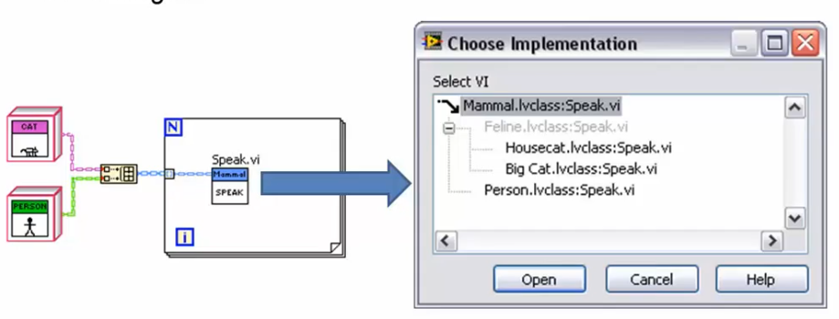
Inheritance in LabVIEW
Init an Increment are “magic” Dynamic dispatch VI's:
Same VI name on each class
Different block diagrams
LabVIEW chooses which VI to run

Slide 9
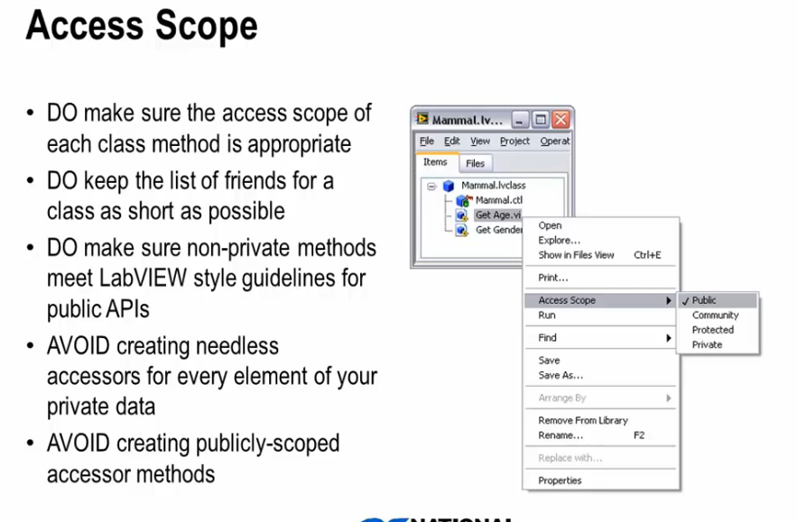

Slide 10
Design Patterns
A design pattern is a general reusable solution to a commonly occurring problem in software design
State machine / Queued Message Handler (QMH)
Functional global
Master/Slave design pattern. (Notifier Operations)
Producer/Consumer design pattern. (Data in Queue)
Queued Message Handler (QMH)

Slide 11
Object-Oriented (OO) Design Patterns
Template Method (aka Channeling) Pattern
Aggregation Pattern
Factory Pattern
Hierarchy Composition Pattern
Decorator (Wrapper) Pattern
Strategy (Policy) Pattern
Active Object
Delegation Pattern
Visitor Pattern
Specification Pattern
Singleton Pattern

Slide 12
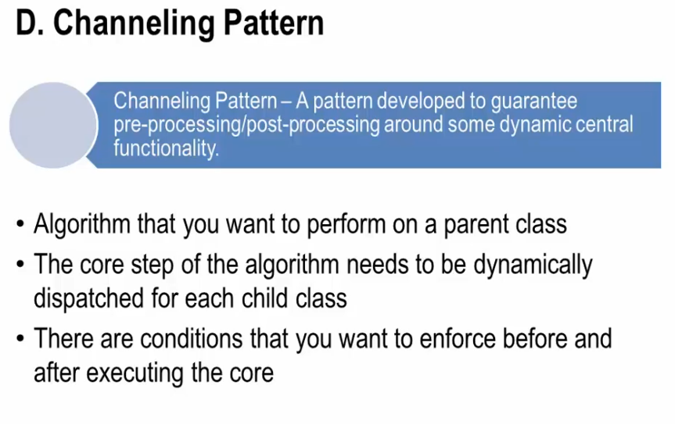

Slide 13
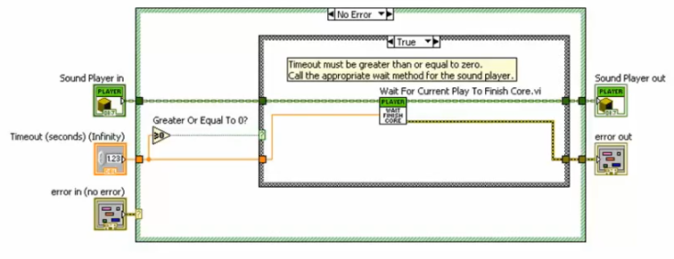
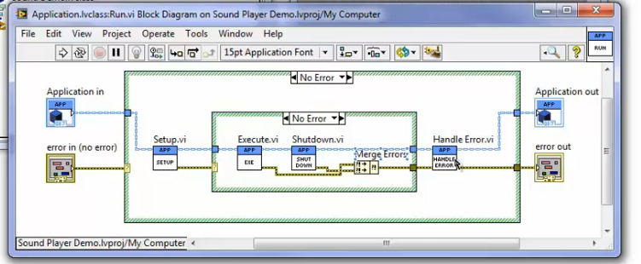
Channeling Pattern Example

Slide 14
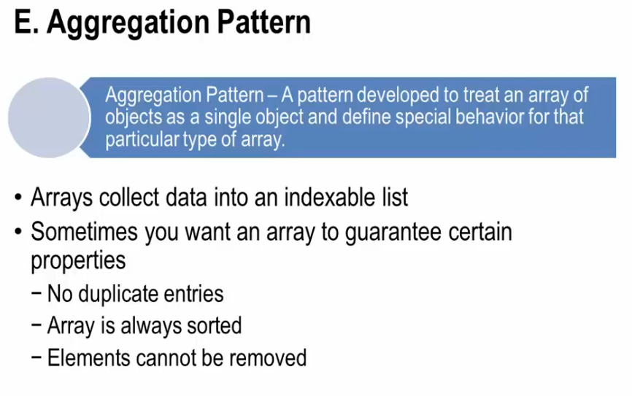

Slide 15
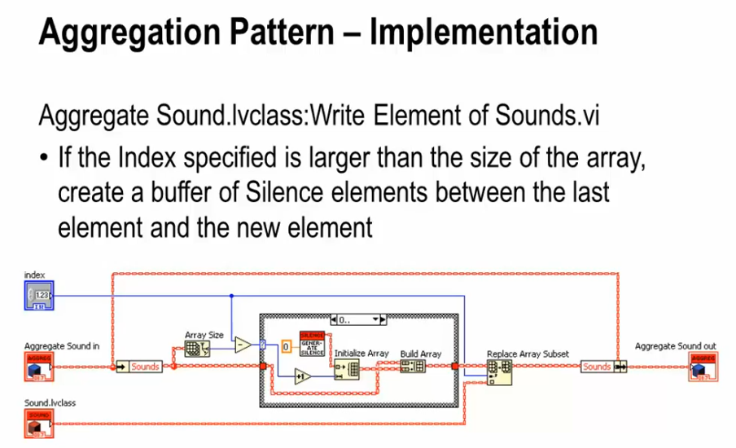

Slide 16
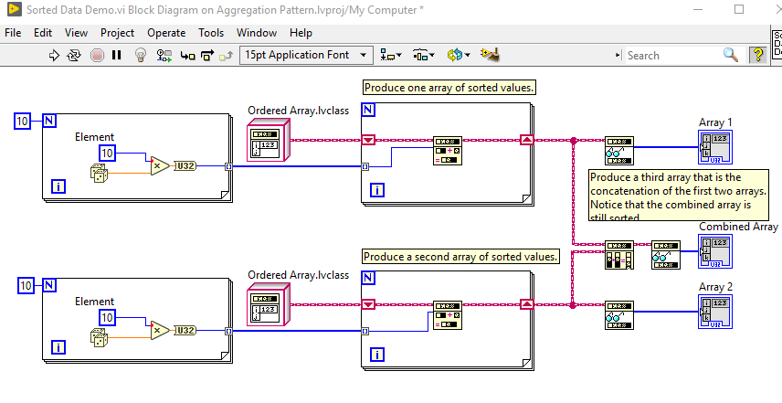
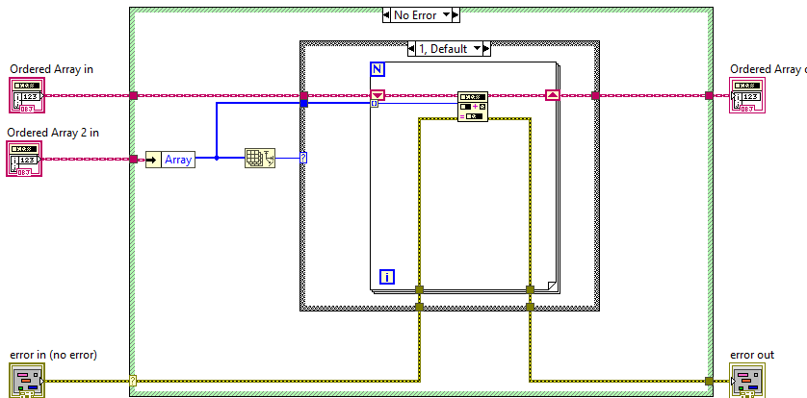
Aggregation Pattern Example

Slide 17
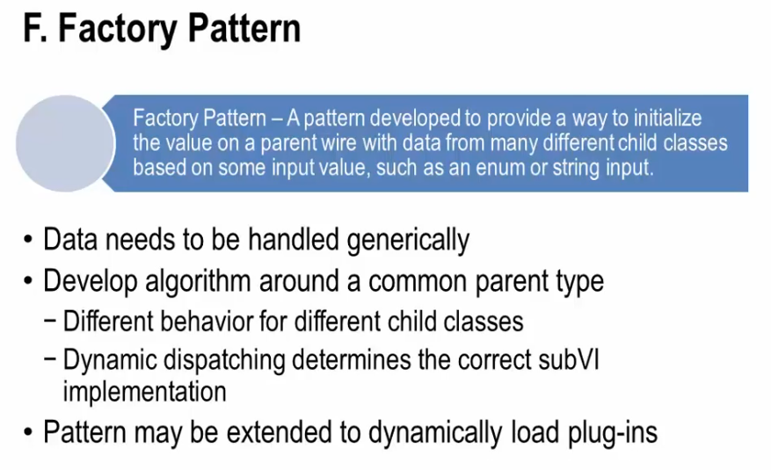

Slide 18
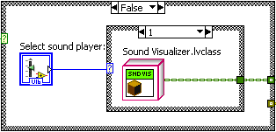
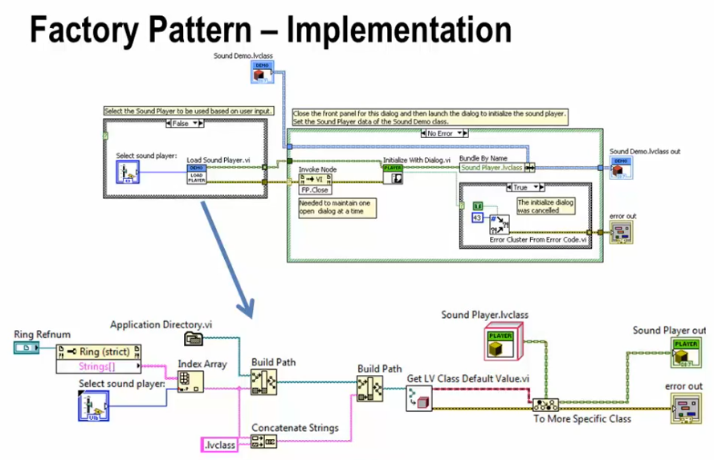

Slide 19
Factory Pattern
Verify that classes are now dynamically loaded into memory.
❑ Remove Child Class from the project. This is done so that we can build an executable that will only load the child of Sound Player into memory that is actually used.

Slide 20
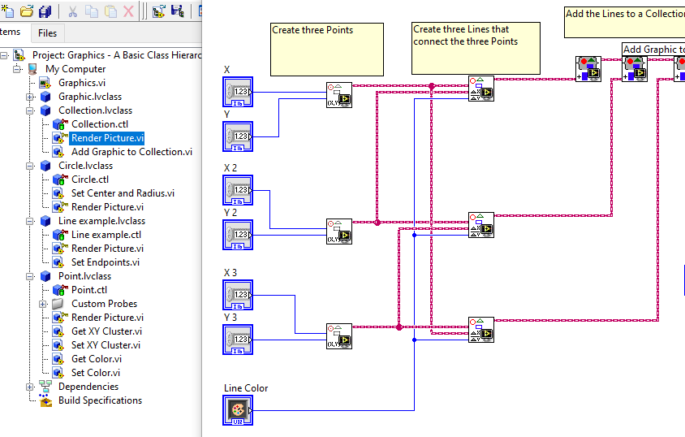
Hierarchy Composition Pattern

Slide 21
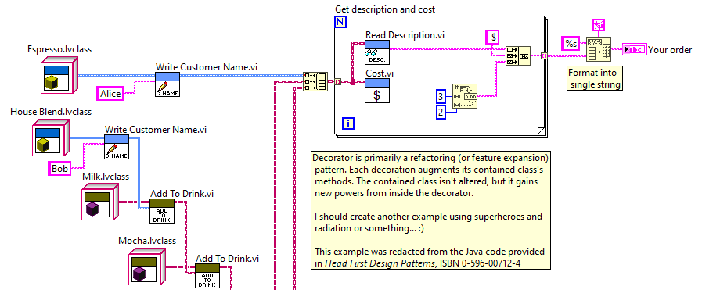
Decorator (Wrapper) Pattern
Extend a concrete object’s responsibilities dynamically. Extend the features of an existing class without refactoring tested code.

Slide 22
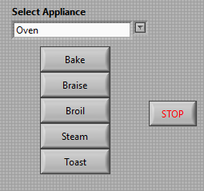
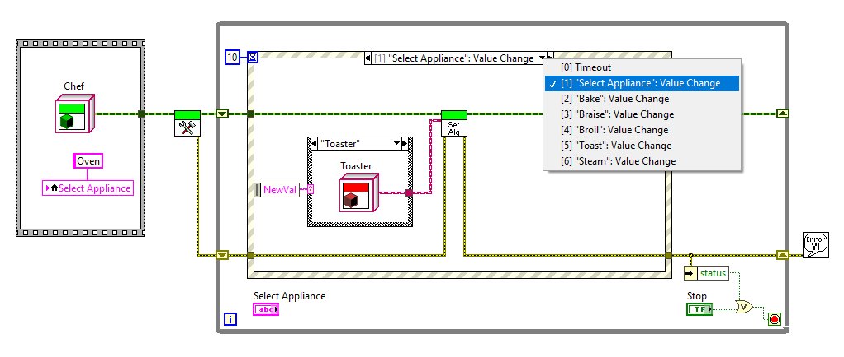
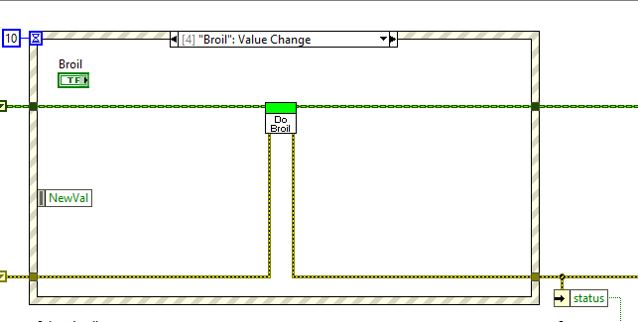
Strategy Pattern
Change the behavior of a class's method without having to edit the method's implementation. Change a method's behavior dynamically, at run-time. Allow future expansion of a method's behaviors via a plug-in framework.

Slide 23
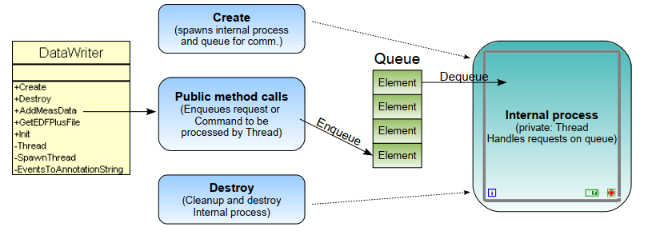
Active Object Pattern

Slide 24
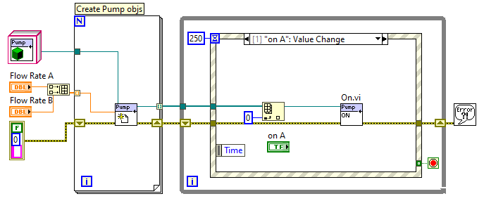
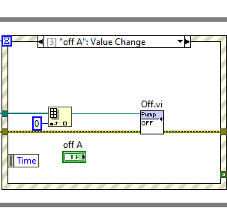
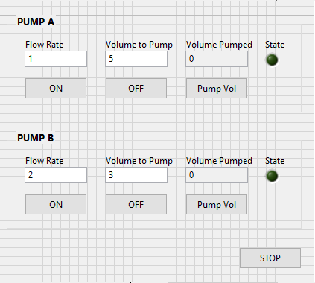
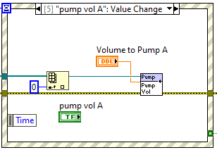
Active Object Pattern Example

Slide 25
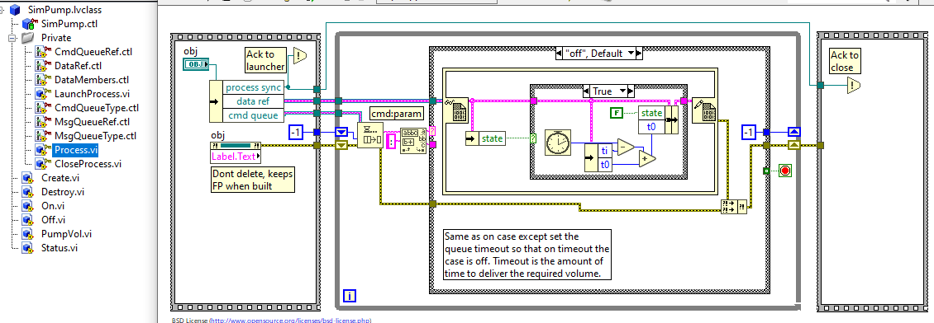
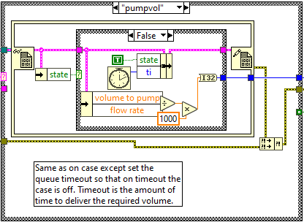
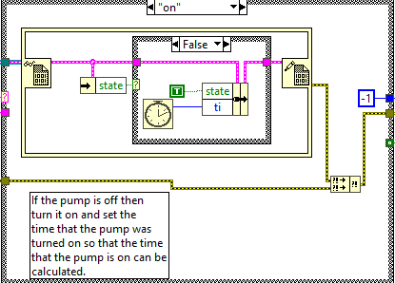
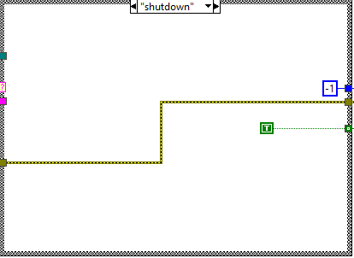
Active Object Pattern Example: Process vi

Slide 26
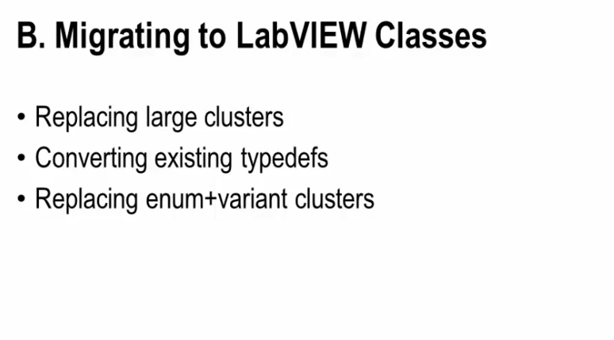

Slide 27
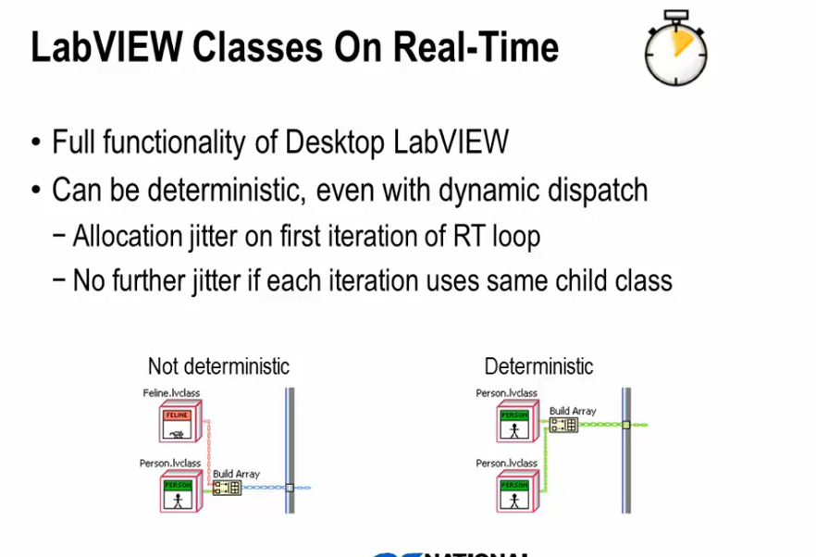

Slide 28
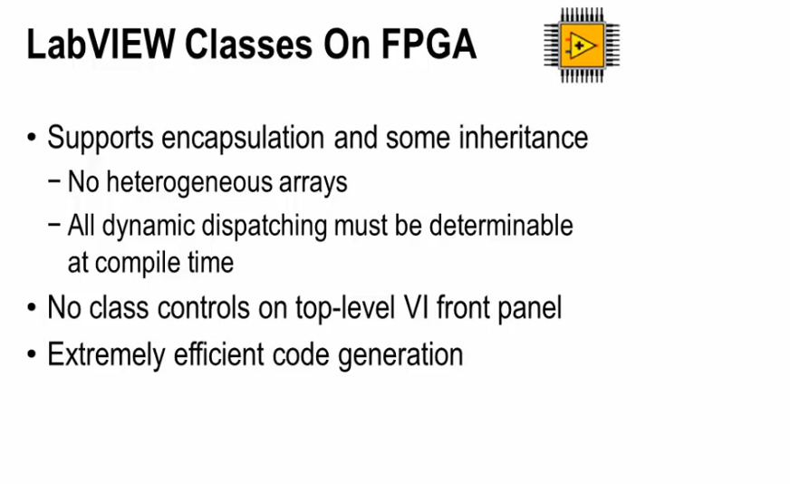

Slide 29
Other Pattern
Visitor Pattern To write a traversal algorithm of a set of data such that the traversal can be reused for many different operations.
Singleton Pattern - Guarantee that a given class has only a single instance in memory.
State Pattern, Factory Pattern - this is an example of a UI Plugin Framework that illustrates the use of both patterns
Hardware Abstraction Layer - Illustrates the use of classes and a factory pattern

